Slide 1
세상 모든 자연과 통하다
GLOBAL ECO THE SAEM
Saemmul Nail

Slide 2
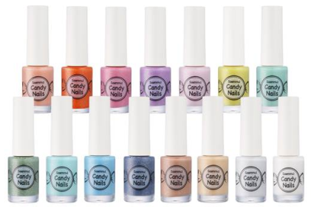
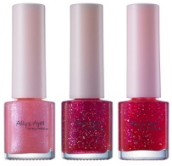
Profile of Saemmul Nail polishes
Product Name | Saemmul Nail
Concept | A new collection of nail polishes that offers diverse trends, textures and colors in more upgraded formulation , (Replacement of Ally’s Ajell line) Beautiful color palette and diversity will attract customers into the store. (Leading Product)
Sub-category | Product | SKU | KRSP [₩] | Color Concept
 | Vivid Nail | 12 | 1,500 | Vivid, popular colors
 | Candy Nail | 15 | 1,500 | Offers sweet color like a candy in very unique ‘sand-like’ texture.
 | Pastel Nail | 10 | 1,500 | Feminine, lovely pastel color
 | Hot Summer Nail | 5 | 2,000 | Neon colored polishes
 | Nude Nail | 5 | 1,500 | Neutral toned colors
 | Care Nail | 3 | 1,500 | Products for nail protection
 | Nail Remover | 1 | 1,500 | Nail color remover without residue.
Renewal Direction
Ally’s Ajell
Renewal Point
Saemmul
Nail line reorganization: Saemmul line will be the representative of approachable, trendy and low-priced line.
To play role as leading loss leader products.
Quality Improvement
Features
Quality improvement --> Better color presentation, More shine, Longer lasting !
Greater color & texture variation
Contains caring ingredients (White birch tree sap, Acacia honey and sunflower seed for nail protection.)
Free of 4, Gentle formula: Didn’t use harmful additives (DBP, Acetone, Formaldehyde, Toluene)

Slide 3
Color Charts
Vivid Nails
Color Name | Color | Color Name | Color
01. Vivid Red |  | 07. Vivid Turquoise
02. Vivid Orange |  | 08. Vivid Khaki
03. Vivid Grapefruit |  | 09. Vivid Navy
04. Vivid Pink |  | 10. Vivid Black
05. Vivid Light Pink |  | 11. Pearl Necklace
06. Yellow Vivid |  | 12. The White Shirt
Hot Summer Nails
Color Name | Color
01. Hot Summer Pink
02. Hot summer orange
03. Hot summer Yellow
04. Hot summer Green
05. Hot summer Blue
Pastel Nails
Color Name | Color
01. Pastel Red
02. Pastel Coral
03. Pastel Pink
04. Pastel Lavender
05. Pastel Orchid
06. Pastel Yellow
07. Pastel Mint
08. Pastel Green
09. Pastel Aqua
10. Pastel Blue
Candy Nails
Color Name | Color | Color Name | Color
01. Peach Candy |  | 09. Peppermint Candy
02. Citrus Candy |  | 10. Cream soda candy
03. Plum Candy |  | 11.Raspberry Candy
04. Grape Candy |  | 12. Cholcolate Candy
05. Strawberry Milk Candy |  | 13. Almond Candy
06. Lemon Candy |  | 14. Wedding Dress
07. Green Tea Candy |  | 15. Wedding Bouquets
08. Military Star Candy

Slide 4
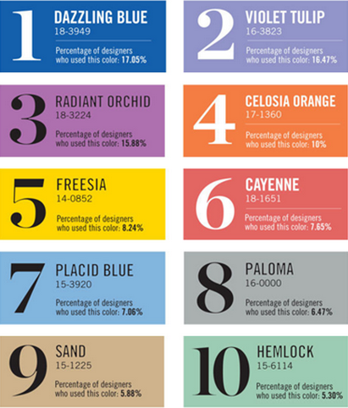
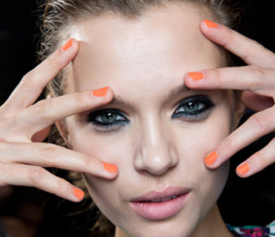
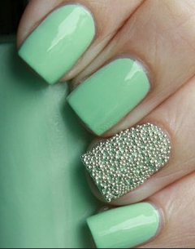
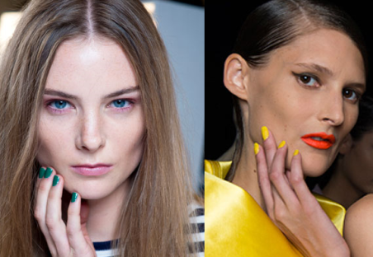
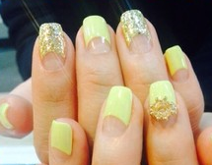
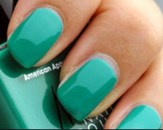
Color Charts & Trend
Nude Nails
Color Name | Color
01. Nude Stone
02. Nude Cocoa
03. Nude Berry
04. Nude Almond
05. Nude Coffee
Nail Care & Remover
Color Name | Color
01. Base Coat
02. Gel Top Coat
03. Nail Agent
Nail Remover
Color Trend 2014 SS
Androgynous
Warm modern
Various pastel tones
Restful in Nature
Low Chroma level
Warm, sweet green yellow
Soft blue

Slide 5
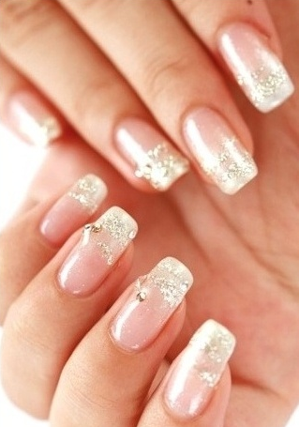
Application Ideas
Sample Look 1 – Colorful French
Hot, trendy French nail with pop colors.
Product used;
Base: Nude nail 02 nude cocoa
Vivid Nails 04 Vivid Pink
Vivid Nails 07 Vivid Turquoise
Vivid Nails 06 Vivid Yellow
Vivid Nails 02 Vivid Orange
Vivid Nails 05 Vivid Light pink
Sample Look 2 – Urban Chic
Attractive urban chic style with deep toned colors
Product used;
Vivid Nails 01 Vivid Red
Vivid Nails 09 Vivid Navy
Sample Look 3 – Gorgeous wedding
Fancy & romantic like wedding, but not over exaggerated
Product used;
Vivid Nails 11 Pearl Necklace
Vivid Nails 12 White Shirts
Candy Nails 14 Wedding dress
Candy Nails 15 Wedding Bouquets

